Slide 1
Programmable Logic Evolution

Slide 2
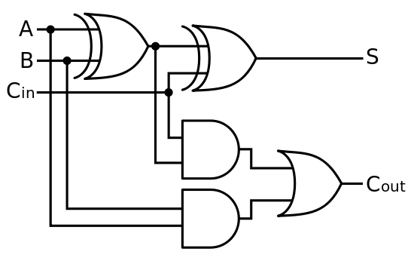
Digital Circuit

Slide 3

Programmable Logic Devices

Slide 4
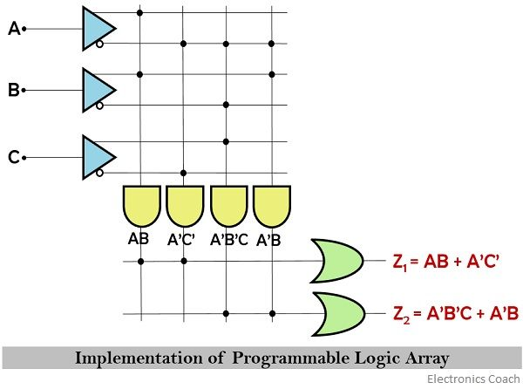
Programmable Logic Devices

Slide 5
Programmable Array Logic
The main difference among these two is that PAL can be designed with a collection of AND gates and fixed collection of OR gates whereas PLA can be designed with a programmable array of AND although a fixed collection of OR gate.

Slide 6
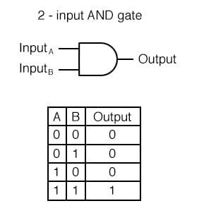
Truth Table

Slide 7
PIN | FPGA IO LOCATIONS
button[0] | W19
button[1] | T17
button[2] | T18
button[3] | U17
button[4] | U18
led[0] | U16
led[1] | E19
led[2] | U19
led[3] | V19
led[4] | W18
led[5] | U15
led[6] | V14
led[7] | V13
clock | W5
reset | V17

